Slide 1

Impacts of ozone air pollution and temperature extremes on vegetation density and ecosystem health
Tai Group for Atmosphere-Biosphere Interactions
Author: Michael Longyin Poon
Co-author: Shirley Xueying Liu
Advised by Prof. Amos P.K. Tai

Slide 2

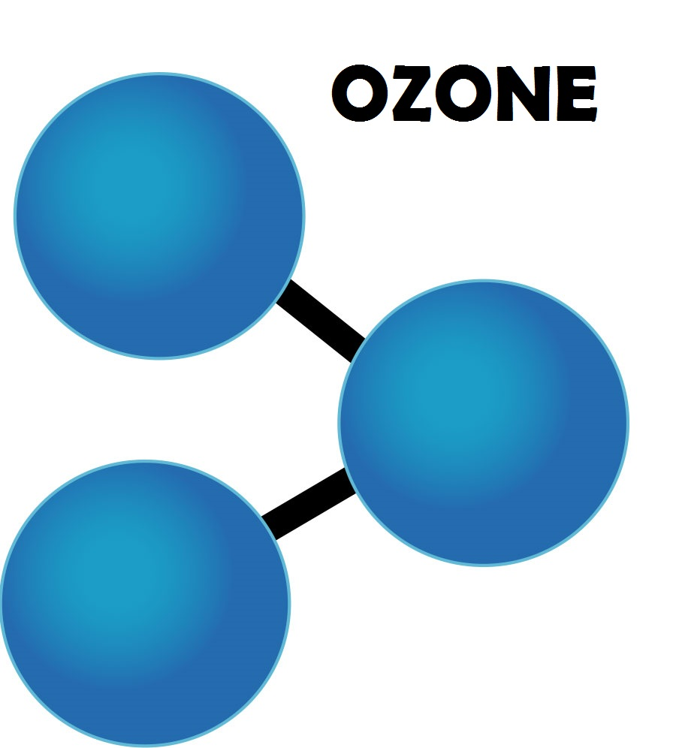


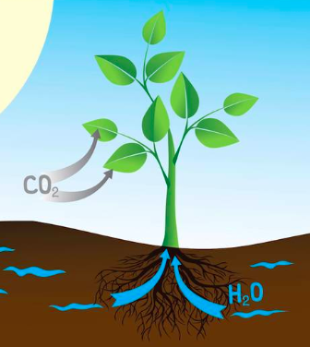
Introduction - Ozone
BVOC

Slide 3
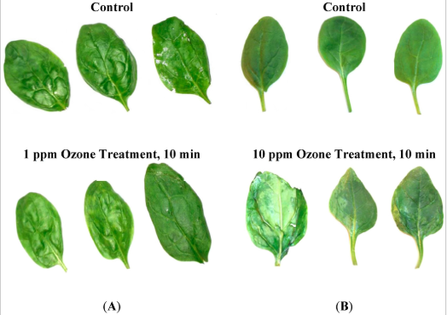
Ozone Damages
Results from research on “Effect of Ozone Treatment on Inactivation of Escherichia coli and Listeria sp. on Spinach”
(A) Impact of ozone exposure levels on visual quality of spinach when treated at 1 ppm ozone concentration for 10 min
(B) Ozone injury/visual damage on spinach when exposed to 10 ppm ozone concentration for 10 min
Notes:
http://www.mdpi.com/2077-0472/5/2/155/htm

Slide 4

Data
Leaf Area Index (LAI)
Defined as total leaf area per unit ground area
MODIS LAI in the US
1982 - 2011 (30 years)
Summer (JJA)
Ozone Concentration
United States environmental Protection Agency (USEPA)
Hourly Ozone concentration measured by each site / monitor
1982 - 2011 (30 years)
Summer (JJA)
Daytime (08:00 - 19:59)
Temperature
United States environmental Protection Agency (USEPA)
Hourly temperature recorded by each site / monitor
1982 - 2011 (30 years)
Summer (JJA)
Daytime (08:00 - 19:59)
All data are averaged to yearly means, gridded to 2x2.5 resolution and confined in the US

Slide 5
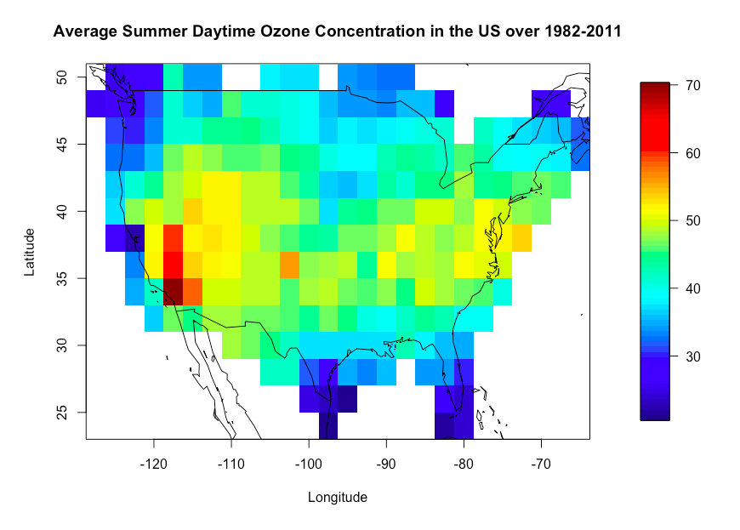
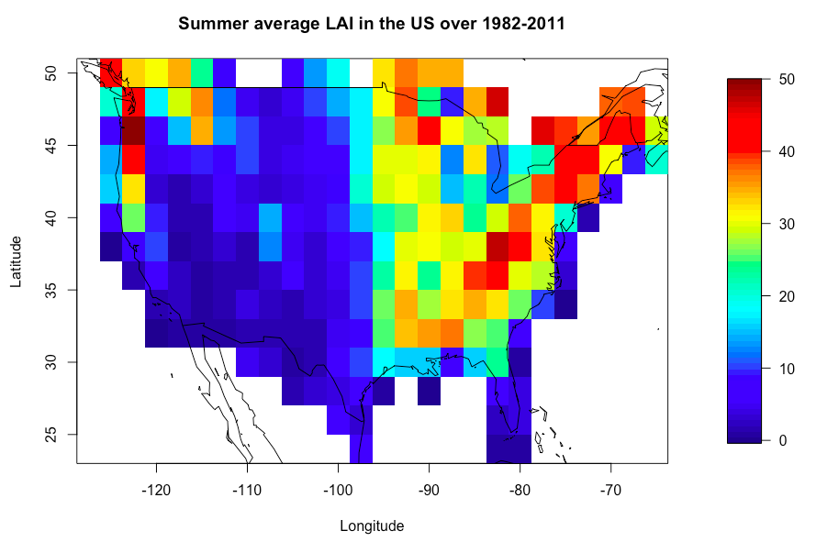
Ozone - LAI

Slide 6
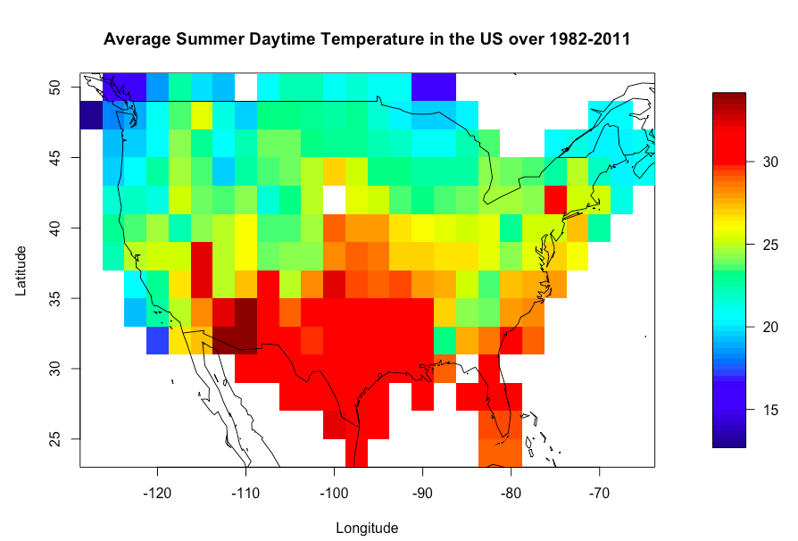
Temperature - LAI

Slide 7
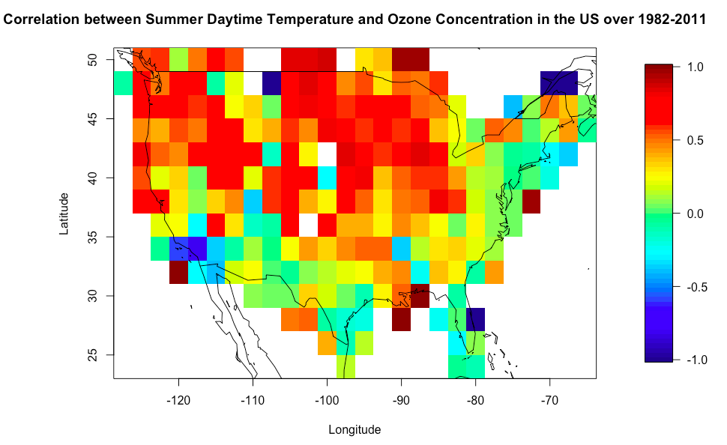
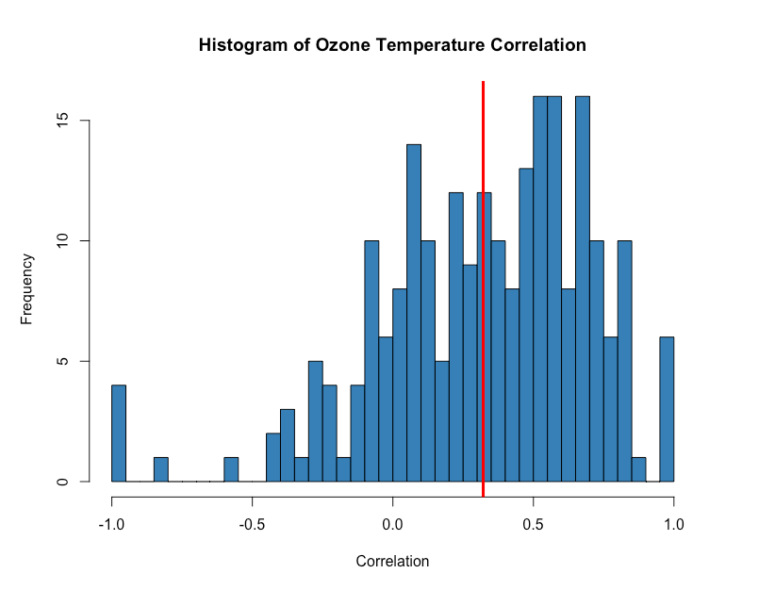
Ozone - Temperature
82%
0.32

Slide 8


Methodology
Partial Derivative Linear Regression (PDLR)
Assume ln(LAI) can be written as a function of ozone concentration and temperature
Take derivatives
Solve the equation to obtain ozone true sensitivity to ln(LAI)
Temperature True Sensitivity
Ozone True Sensitivity

Slide 9
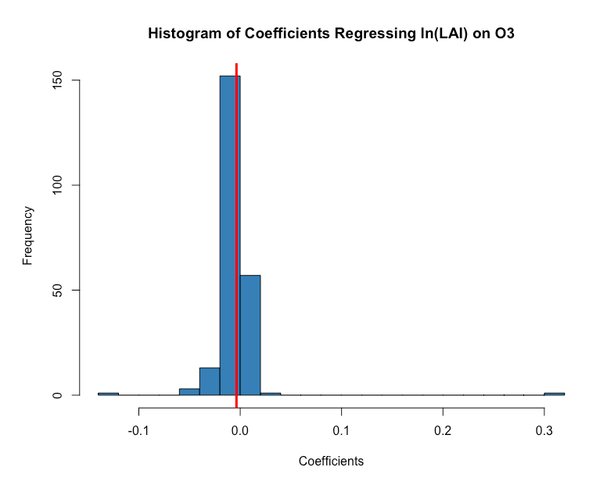
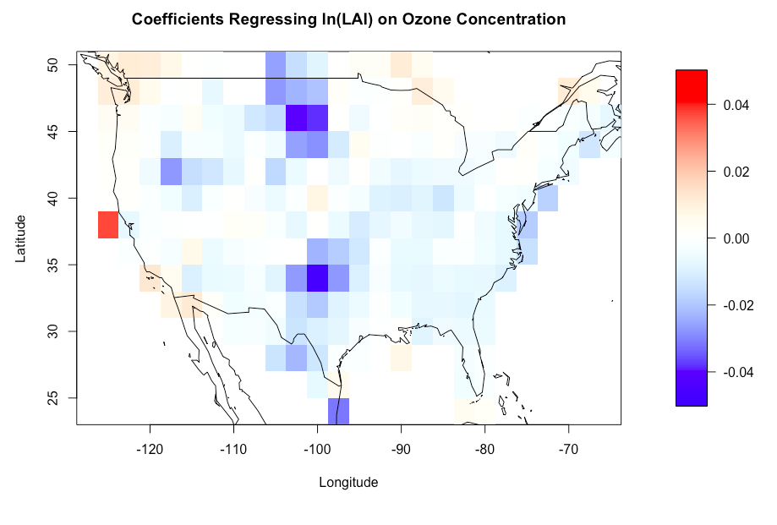
How ln(LAI) response to ozone concentration increases?
-0.0037
74%

Slide 10
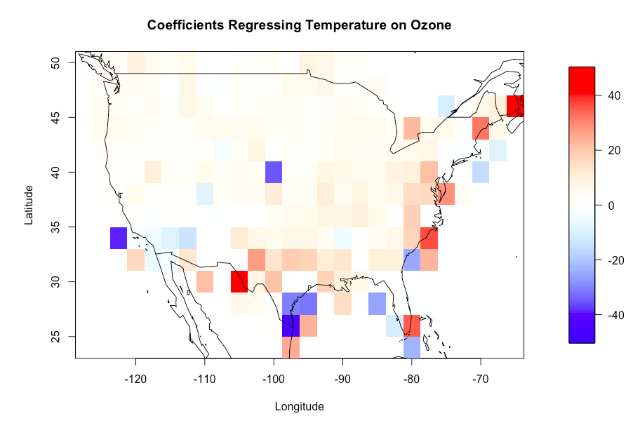
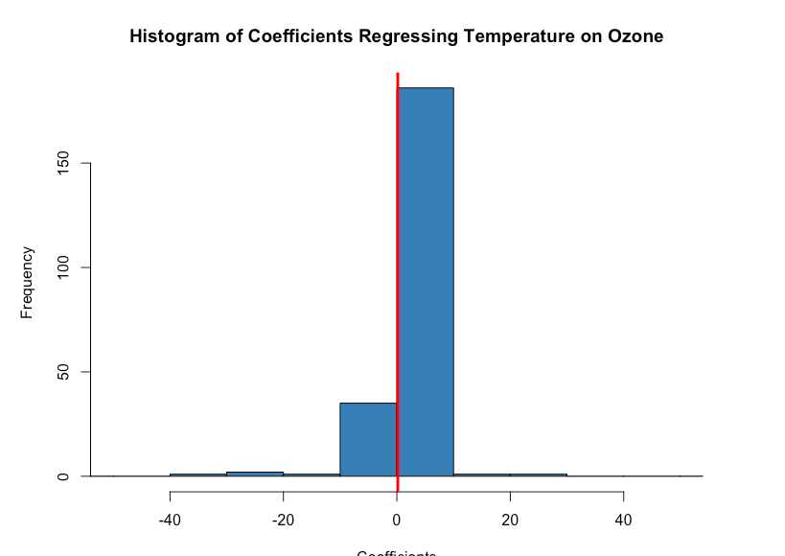
How temperature response to ozone increases?
0.16
82%

Slide 11


Temperature True Sensitivity on ln(LAI)
Estimated using CLM4.5
Simulated SP LAI changes when temperature increases 1 degree Celsius
Take the difference between relative and absolute LAI changes to fix overestimating issues
Temperature rise enhances boreal LAI but decreases tropical LAI

Slide 12
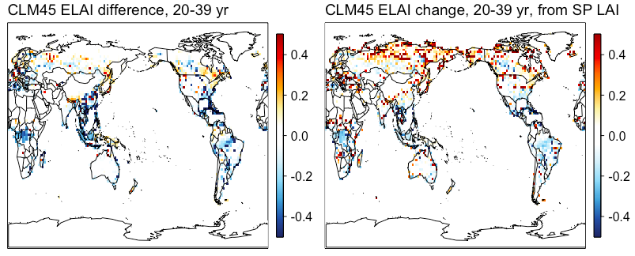
Temperature True Sensitivity on ln(LAI)

Slide 13
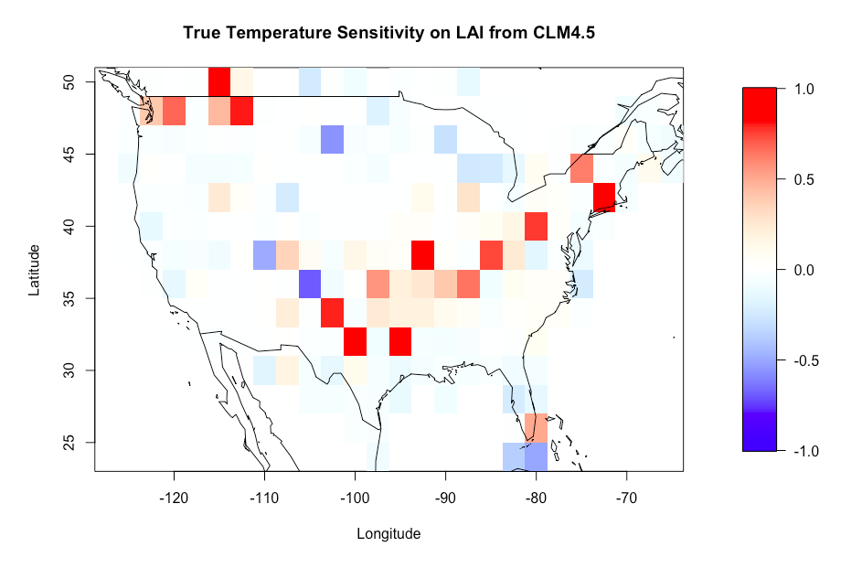
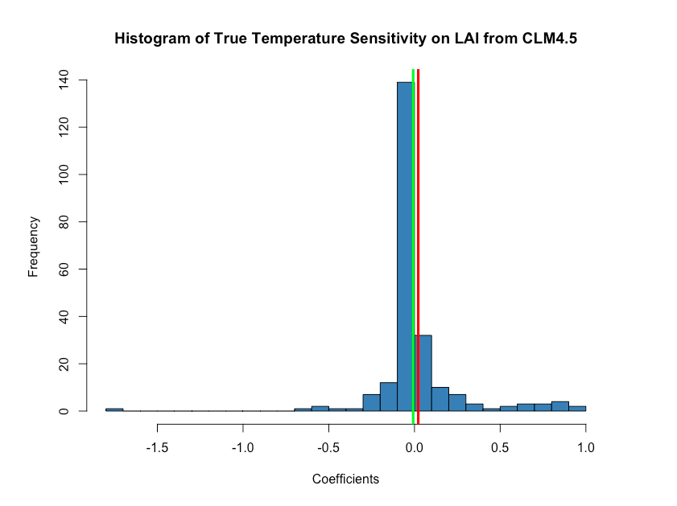
Temperature True Sensitivity on ln(LAI)
55%inc
29%dec
16% -

Slide 14

True Ozone Sensitivity on ln(LAI)

Slide 15
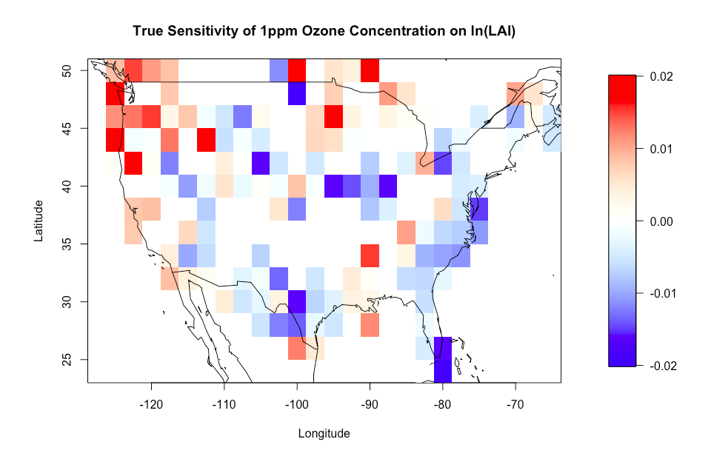
True Ozone Sensitivity on ln(LAI)
60%
-0.003

Slide 16

Conclusion
High ozone concentration decreases vegetation density in general even removed temperature effect
Ozone positive impacts on vegetation density were unable to offset its negative impacts in most cases
Ozone not only damages plant growth but also harmful to vegetation density
May consider adding more confounding variables (ex. precipitation and CO2 concentration) to further capture the true sensitivity of ozone on vegetation density

